Slide 1
Slice IT !
By Joseph Grados, Ashley Mendez, Anaya Yorke, and Gregory Smith
Georgia Gwinnett College
TAP
Fall 2022| STEC 4800

Slide 2
Pre-Survey
Please take our pre-survey before we start on the workshop: https://ggc.az1.qualtrics.com/jfe/form/SV_5iEEPaoyKE0nOQe

Slide 3
Technology Ambassadors Program
Members:
Joseph Grados
Ashley Mendez
Gregory Smith
Anaya Yorke
What do we do in TAP:
Expo (to showcase our game)
CREATE
Workshops

Slide 4

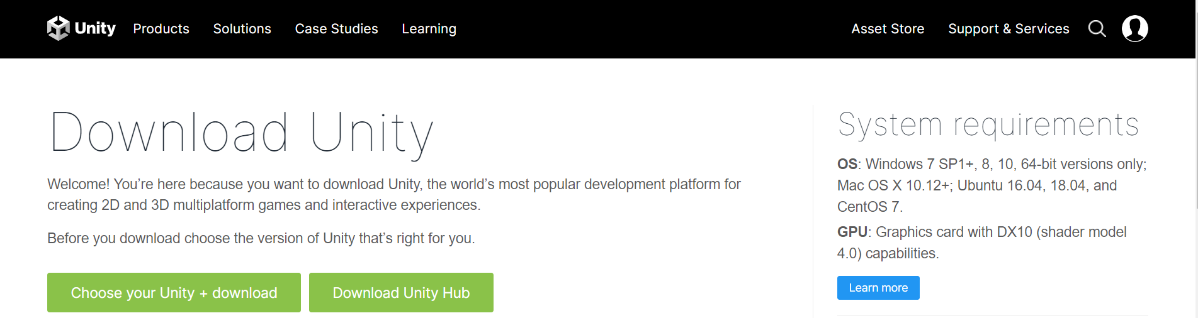
Unity
A software development application designed to create other application for a multitude of different hardware like PC, mobile devices, and video game consoles.
C#
Visual Studio Code
Unity Document
Works On:
Windows (32 or 64 bits)
MAC
Linux

Slide 5
What is a boolean?
A boolean is a data type that is used for conditional statement.
Some of the syntax for boolean is &&(for and) ||(for or) and !(for not), and when combine it can change if the boolean statement is logically right or not.
Examples:
True or True = True (as no matter the opinion in the end it’s true)
True and False = False(and means that both conditions need to be the same to appropriately match)
True or !True = True(the or means even that both conditions can be true, and the not sign means it’s not true)

Slide 6








Question 1
Which of the following expression “color is green” true?
Hint – three answer will be true
Red Sphere
Green Sphere
Blue Sphere
Red Cube
Green Cube
Red Cylinder
Green Cylinder
Blue Cylinder

Slide 7


Question 2
Which of the following shapes will make the statement (“shape is cube”) true?
Green Cube
Red Sphere
Blue Cylinder
Orange Cube
Blue Sphere
White Cube
Green Cylinder

Slide 8


Question 3
Which of the following shapes will make the statement “(color is green) AND (color is blue)”?
Green Cylinder
Blue Cube
White Cylinder
Green Sphere
Blue Cylinder

Slide 9



Question 4
Which of the following shapes will make the statement “(color is green) OR (color is blue)”?
Green Cube
Orange Sphere
Orange Cylinder
Blue Cube
Blue Sphere
Red Cylinder
Green Sphere
Green Cylinder

Slide 10


Question 5
Which of the following shapes will make the statement “(color is red) AND (shape is sphere)”?
Yellow Cube
Yellow Sphere
Red Sphere
Blue Cylinder
Orange Cylinder

Slide 11
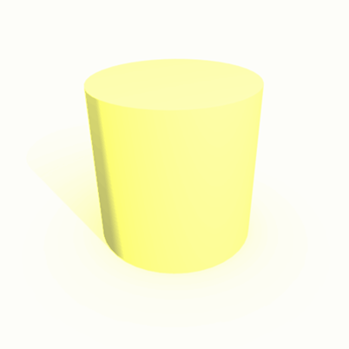
Question 6
Which of the following shapes will make the statement “(color is blue) OR (shape is Cylinder)?
Yellow Cylinder
Blue Cylinder
White Cylinder
Red Cylinder
Green Sphere
Yellow Cube
Blue Sphere

Slide 12
First importantly
Secondly work with a partner.

Slide 13
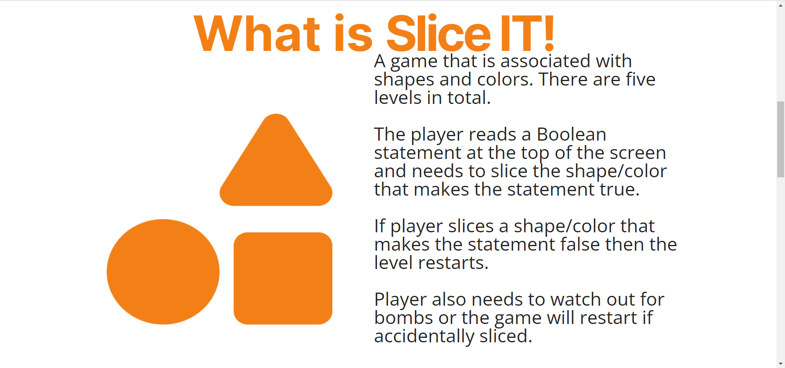
Visit our website!
Slice It! Website: https://tap-project-fall-2022.github.io/Slice-IT/Slice%20IT!%20Website/index.html

Slide 14
Post-Survey
Please if you have the time go do our post survey, as it gives us valuable information on how we did.
https://ggc.az1.qualtrics.com/jfe/form/SV_8IAyAgqFH1SnyJ0

Slide 15

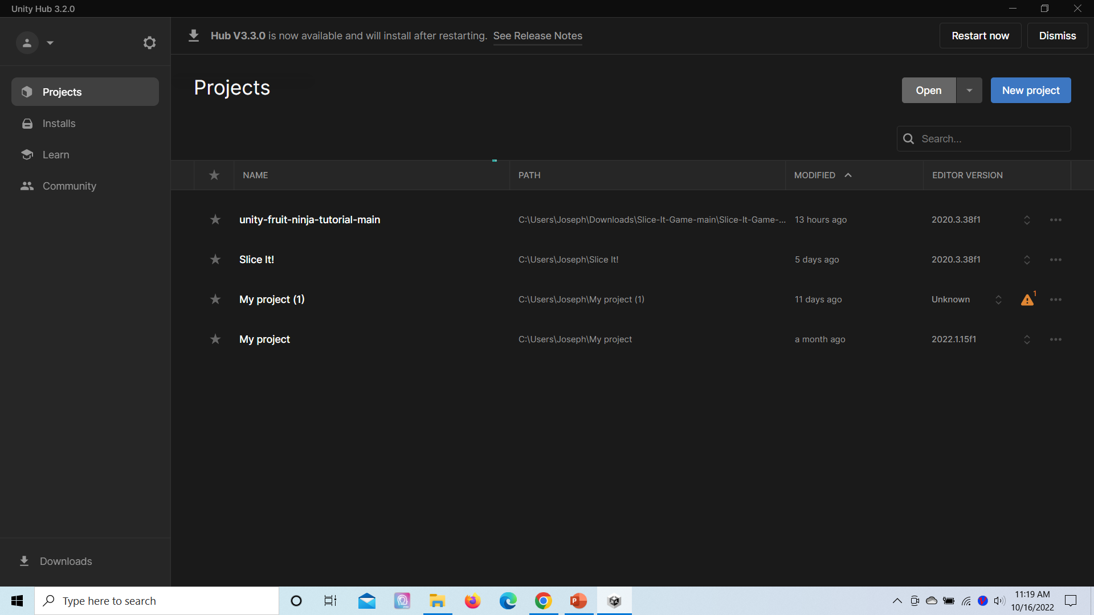
How we made our levels
As we build to game on Unity and can open file on Unity hub.

Slide 16
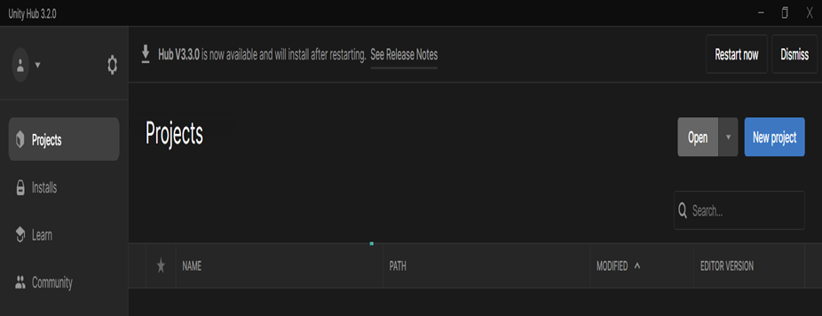
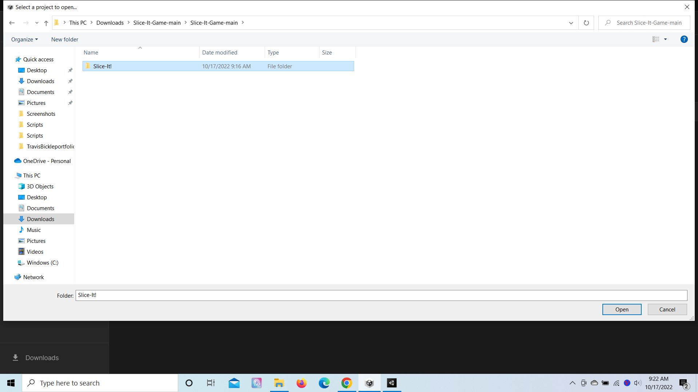
How we made levels
In Unity Hub we hit the open button. Find the Slice It folder, then click it into you reach Slice-It! and then hit open

Slide 17
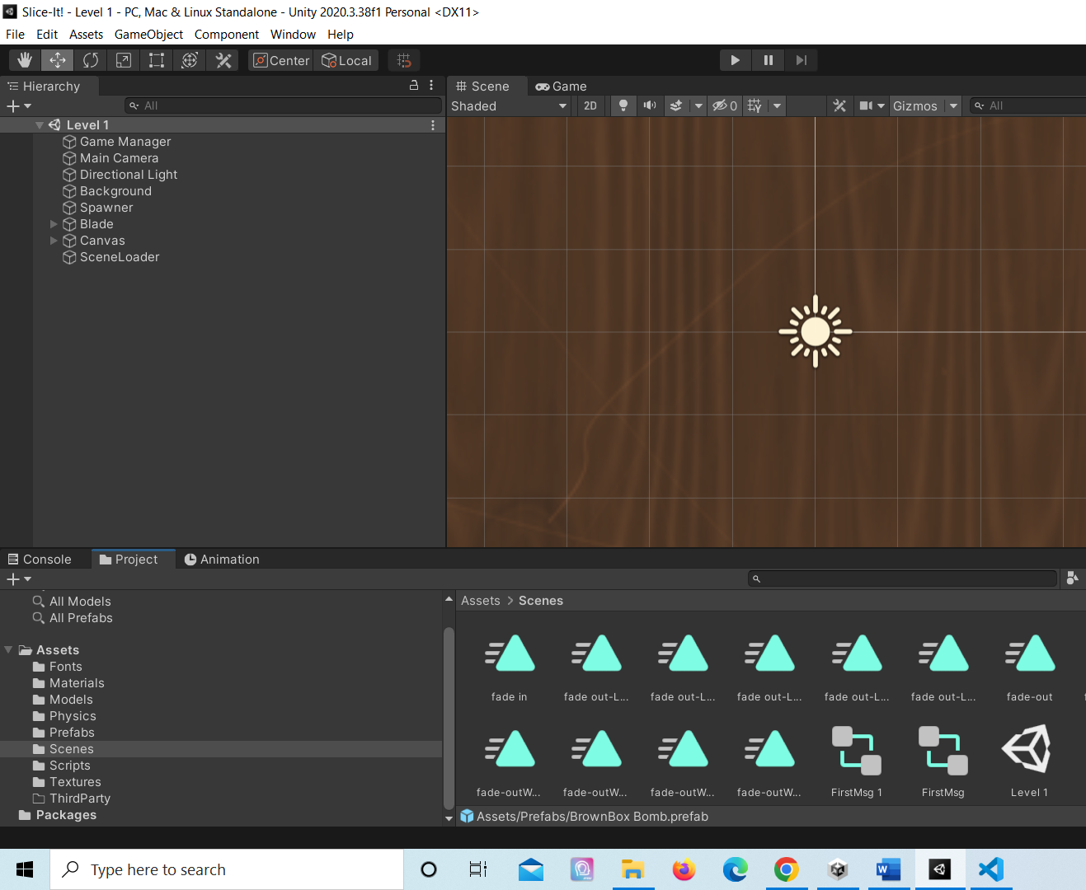
How we made levels
Check all of the scripts, prefabs, and there should be one scene named Level 1

Slide 18
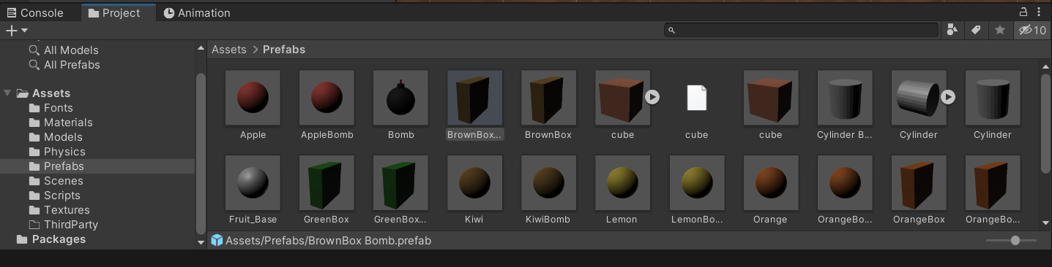
How we made levels
All our prefabs for the game

Slide 19
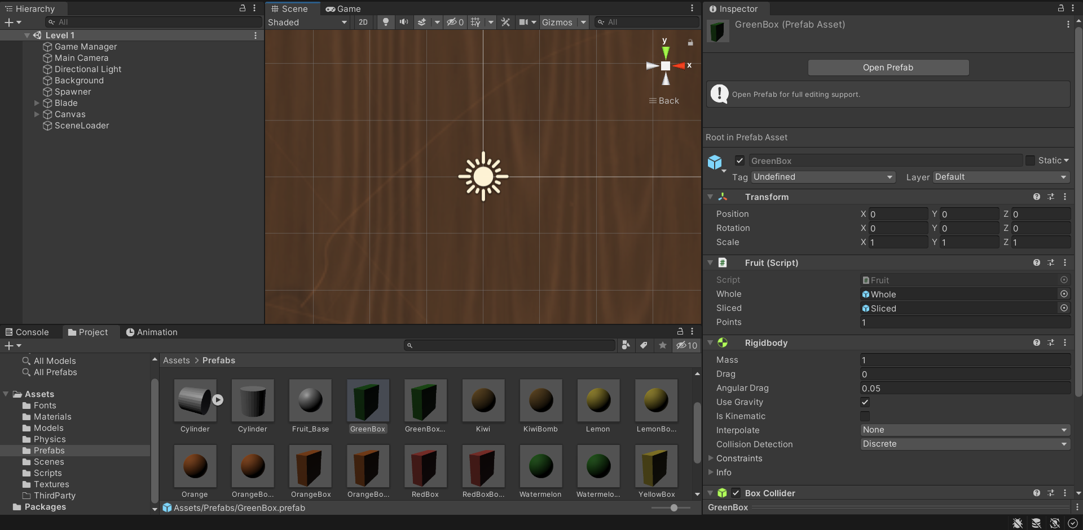
How we made levels
Example:
Clicked on the “GreenBox” prefab

Slide 20
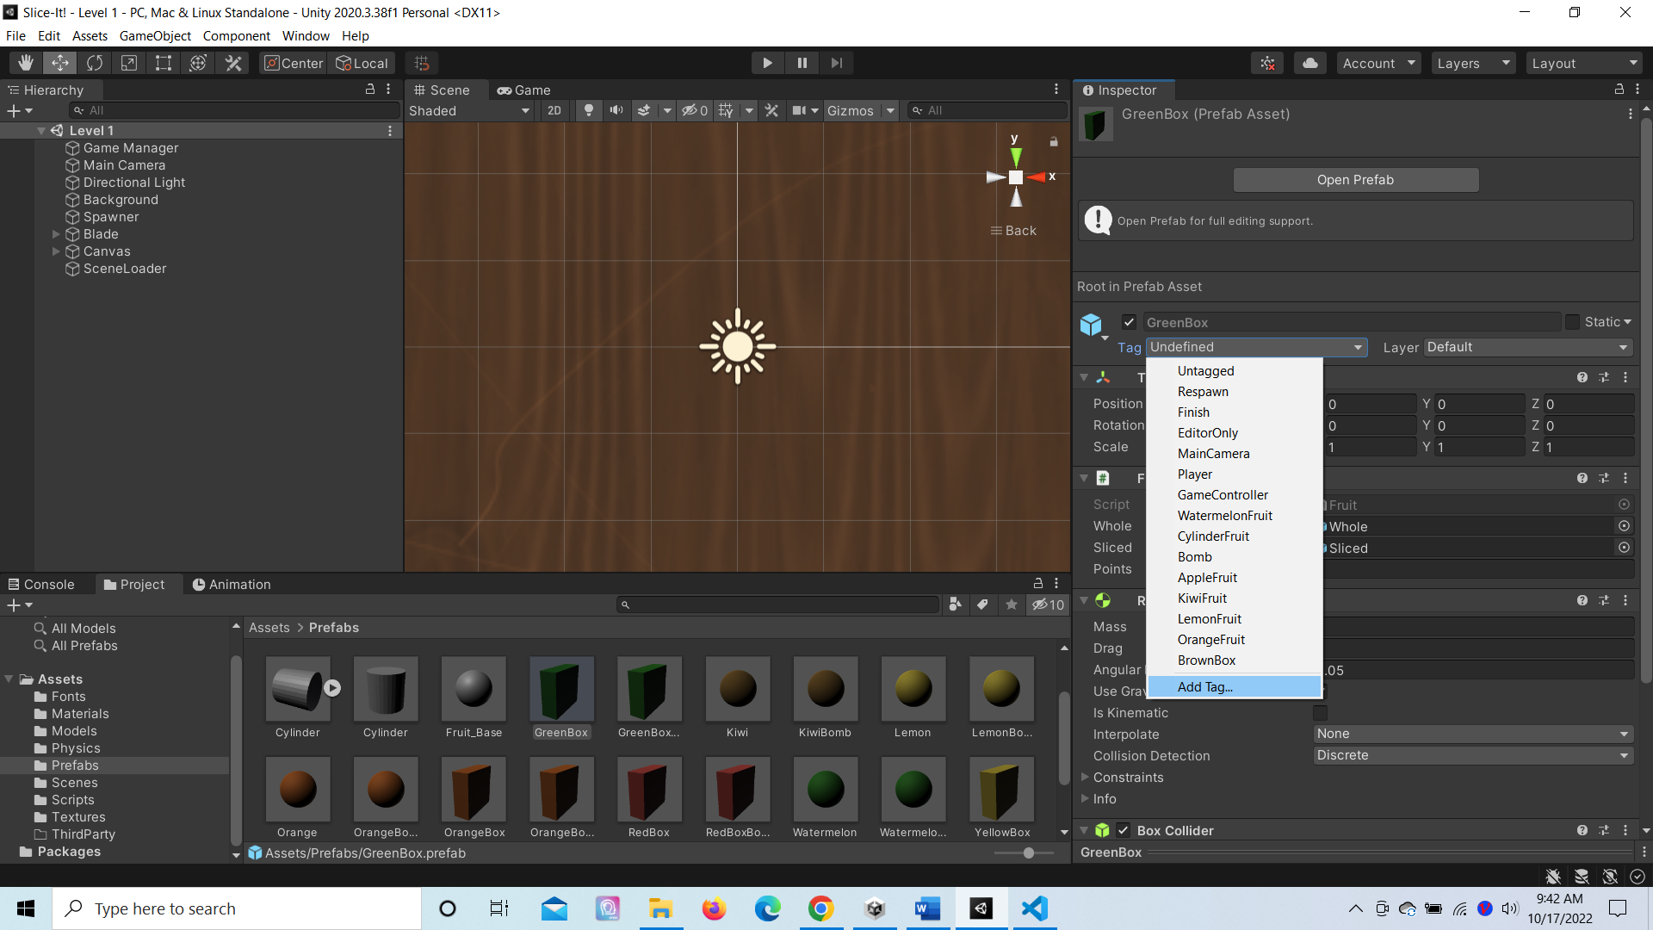
How we made levels
On the tag icon, clicked the add tag sign.

Slide 21
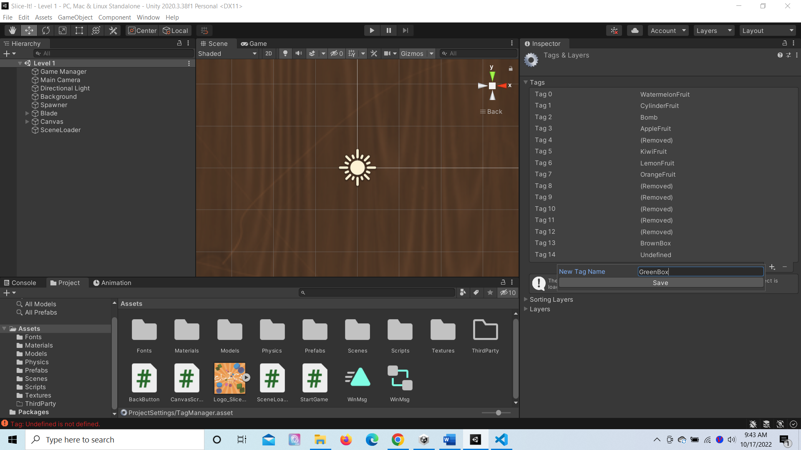
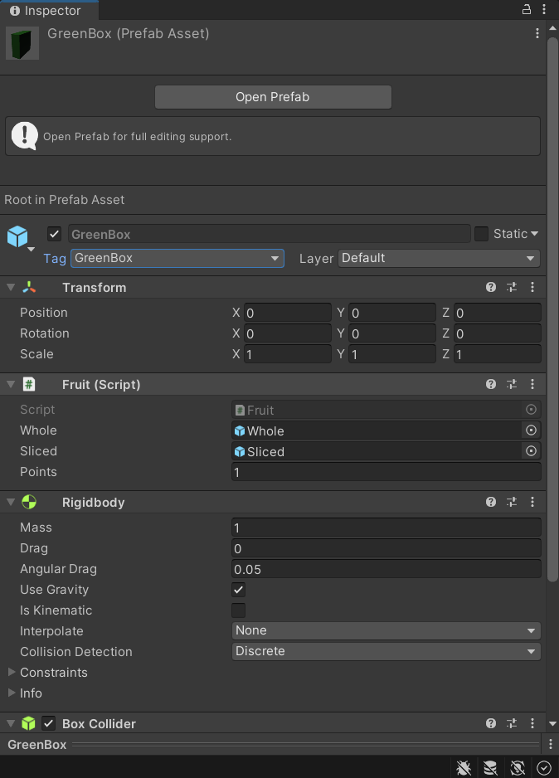
How we made levels
Name this new tag “GreenBox” and go back the it’s prefab and put the tag in the asset.

Slide 22
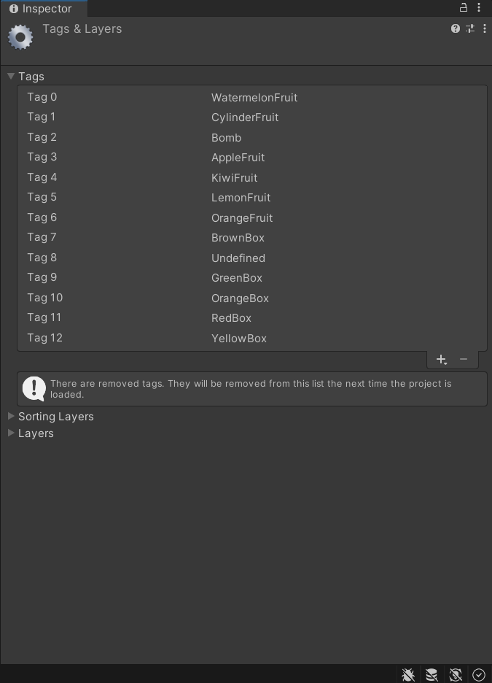
How we made levels
Now repeat this process to all the other prefabs, except the bombs. For reference it’s was helpful to name the tag after the color and shape of the prefab

Slide 23
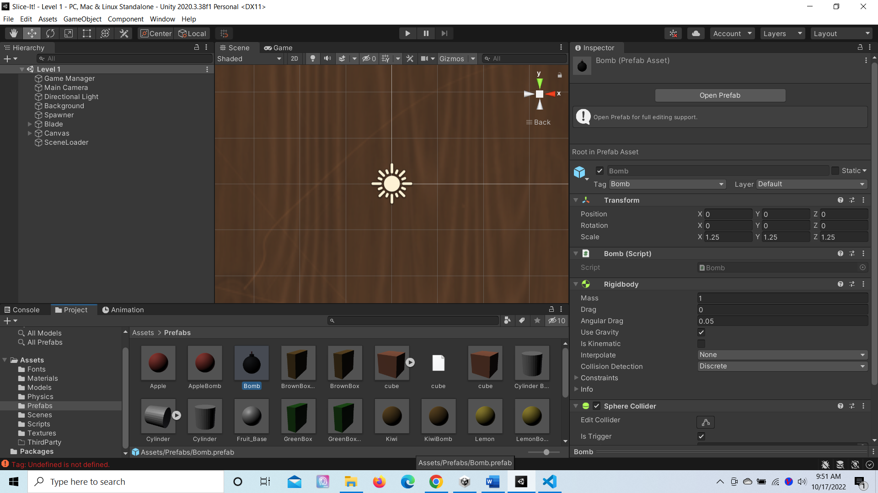
How we made levels
Then we clicked on the bomb prefab

Slide 24
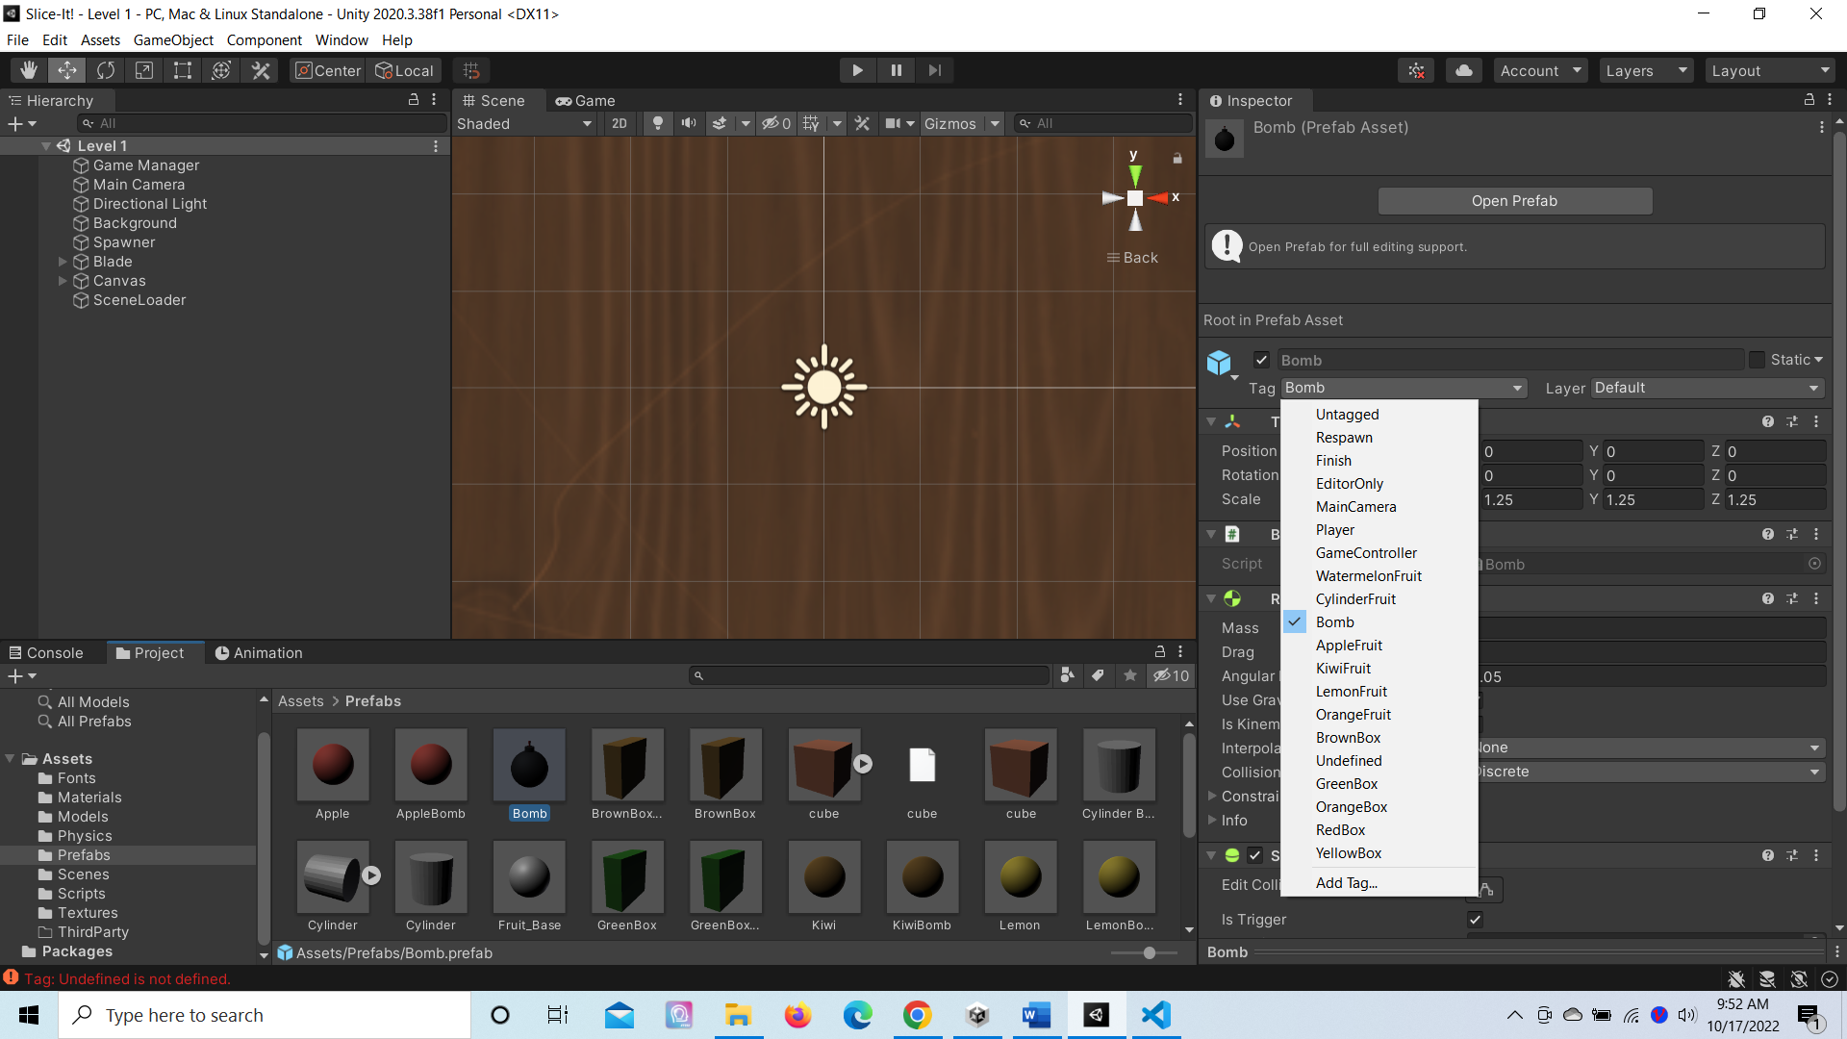
How we made levels
As same as before clicked the tag icon and the plus sign and type “Bomb” as the new tag.

Slide 25
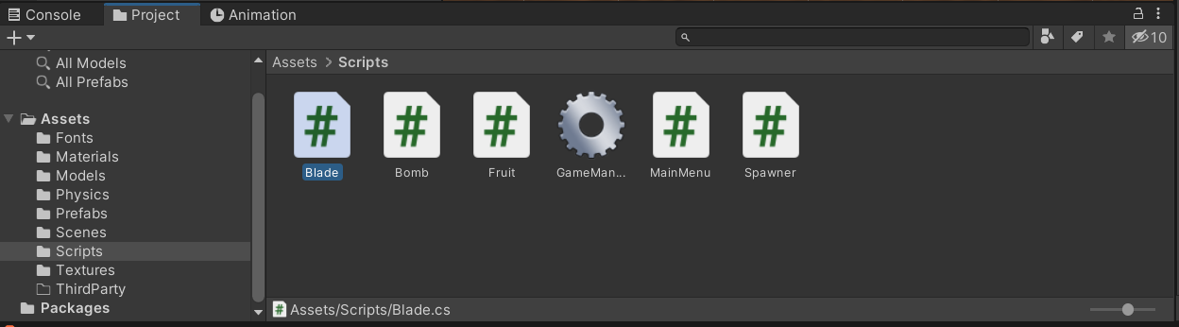
How we made levels
Then we went to the scripts folder, and clicked the blade script.

Slide 26
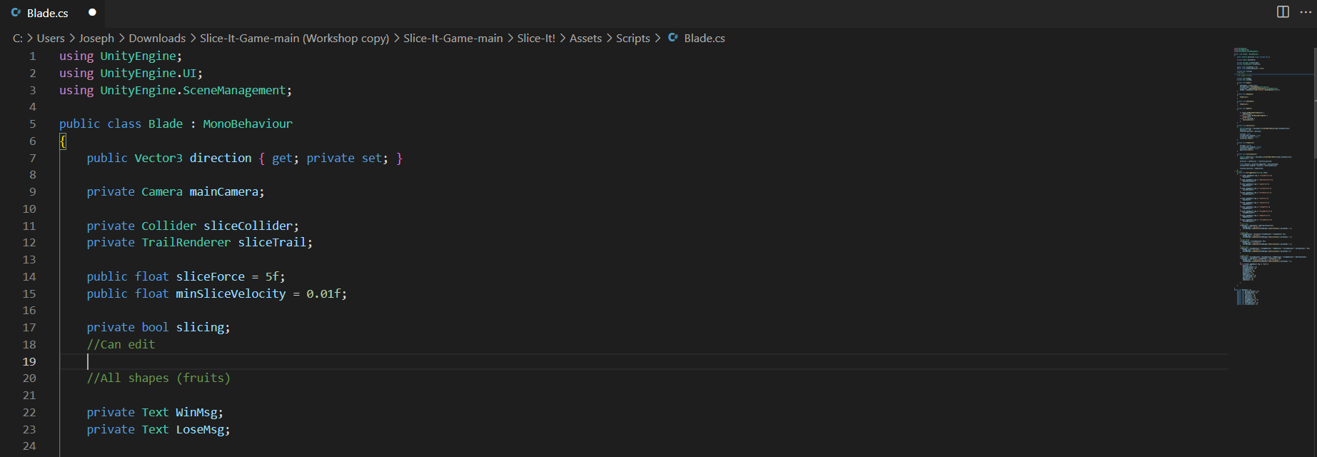
How we made levels
Line 19 it’s where we first start to create some code.

Slide 27
How we made levels
Create a “public int” object within the scripts and put a prefabs name with count added. Then we put an equal sign with a 0 next to it, finally put a semicolon to make it a statement. The photo is an example for reference.

Slide 28
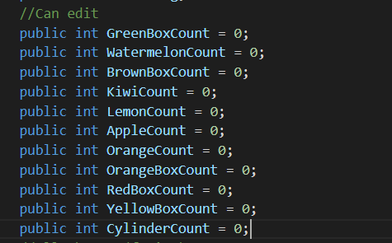
How we made levels
Do the same of all other prefabs, and remember to use the same objects and statements to avoid confusion.

Slide 29
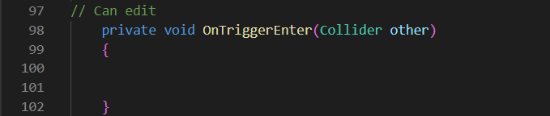
How we made levels
In the blade script go to line 98. Where we are going to type “private void OnTriggerEnter(Collider other){}”.

Slide 30
How made levels
Make space between the method brackets. Then take one of your tags inside this statement. Which is “if (other.gameObject.tag == “GreenBox”){}.

Slide 31
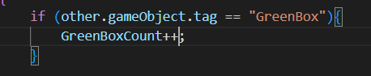
How we made levels
Inside of the if statement bracket put in the count object in the beginning of code by an add increment of one. Example: shown in the photo.

Slide 32
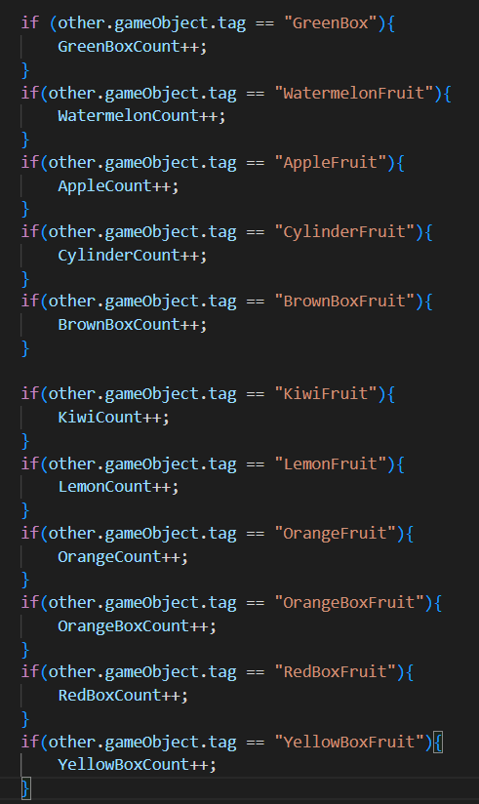
How we made level
Do the same to all other prefab counts.

Slide 33
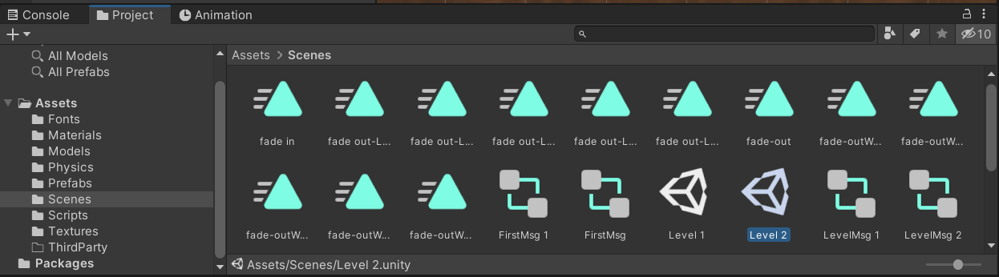
How we made levels
We went back to the game main and go to scenes. Then click on level 1 and press CTRL + D to duplicate the scene. That’s the easy way to make multiple scene with the same format in the Level 1 scene.

Slide 34
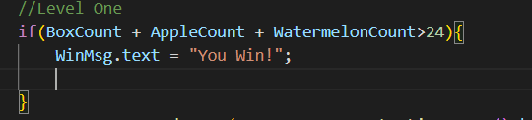
How we made levels
Go back to the blade script and where going to make the condition to transfer different level if the player met the required task.

Slide 35
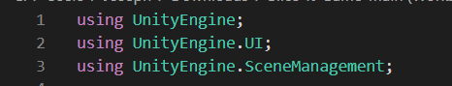
How we made levels
Add UnityEngine.SceneManagement just above the public class method.

Slide 36
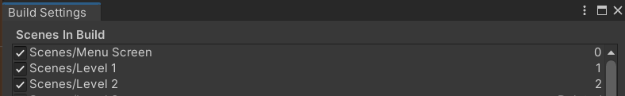
How we made levels
Go back to the unity game menu to click on file, then click on build setting. There you will see the index or order of the scene the game is processing.

Slide 37
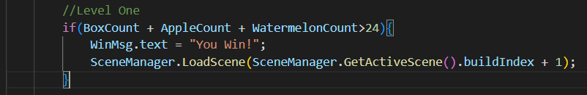
How we made Levels
Under the box count increment codes we will type in a condition or rather a task to make to advance to the next level. We’re use an example from the photo. “SceneManager.LoadScene(SceneManager.GetActiveScene().build index + 1;” will transfer the games into the next scene which should be level 2.

Slide 38
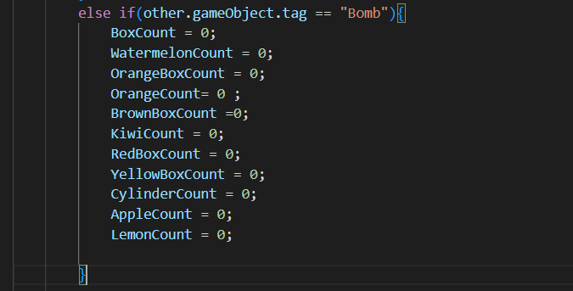
How we made levels
Below the if statement for level one make an else if statement where a player hits a bomb. Which should revert all prefab counts to zero.

Slide 39
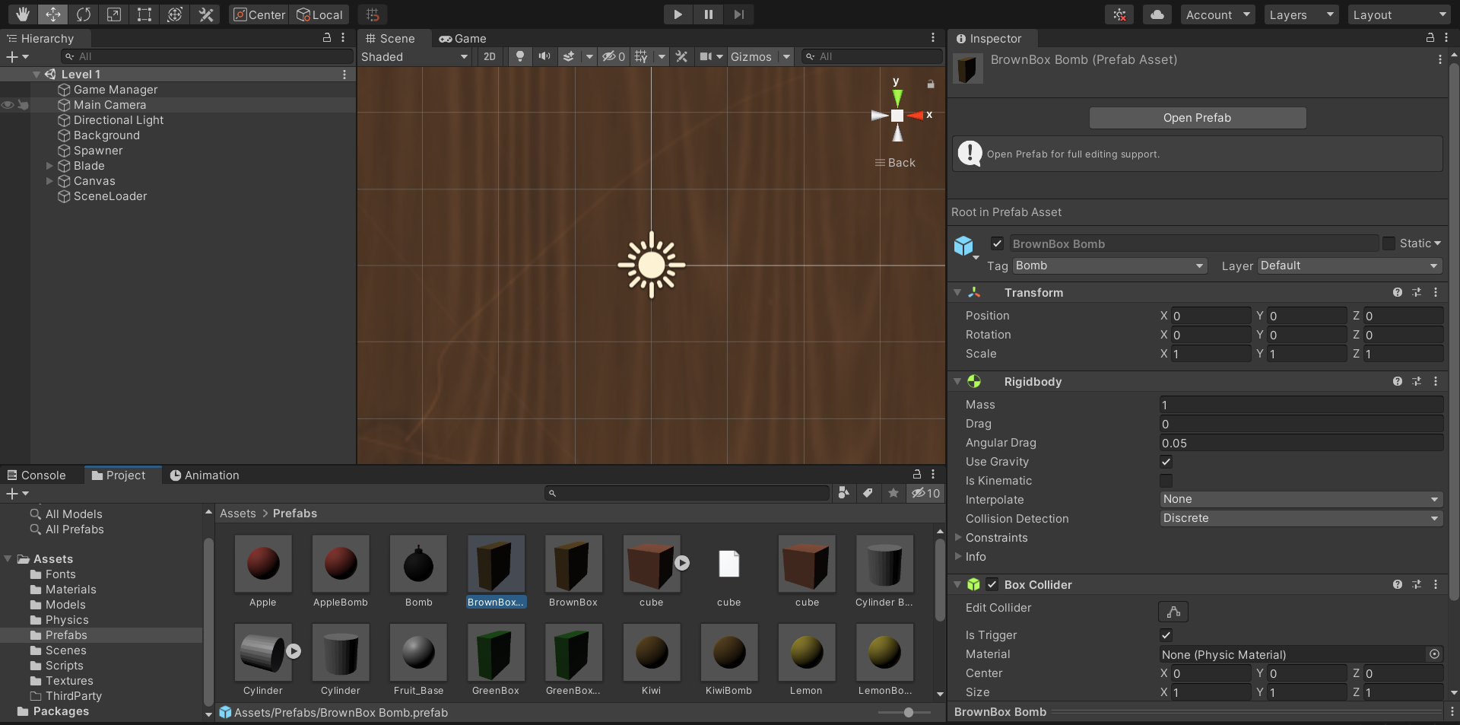
How we made levels
To make fruits as bomb first hit CTRL + D to duplicate them. Then click on the tag icon and put a bomb tag to them.

Slide 40
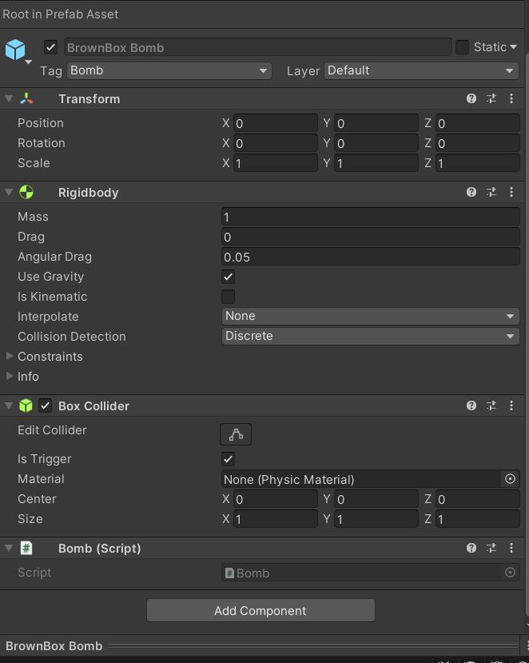
How we made levels
Remove the fruit scripts from them and instead replace it with a bomb scripts which will make it act like a bomb.

Slide 41
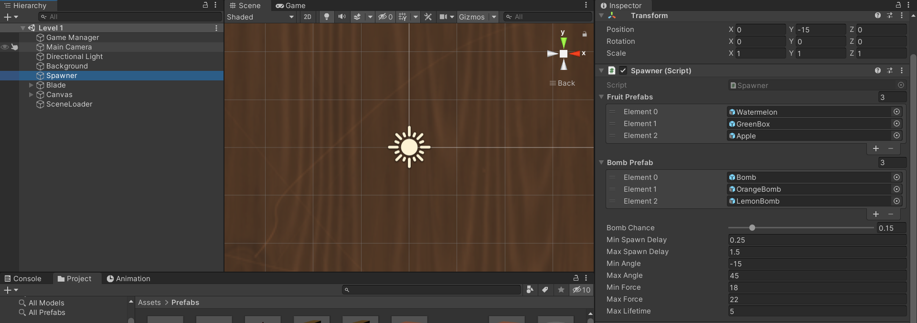
How we made levels
Click on the spawner object and clicked on the prefabs folder. Then drag and dropped the appropriate prefabs object in the fruit array and the bomb array. There you can manuiplate the chances of bombs for difficulty.

Slide 42
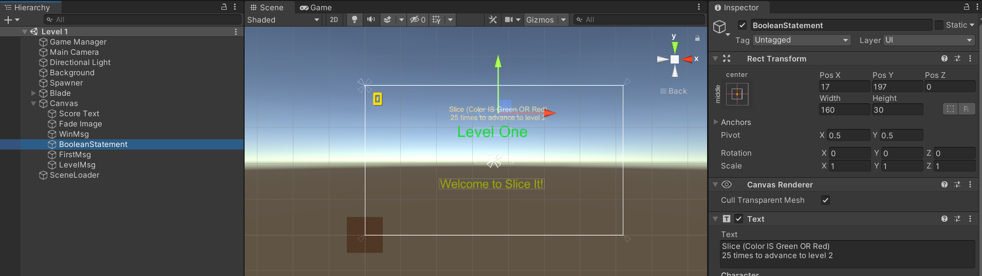
How we made levels
Click the canvas object and duplicate either the “Firstmsg” or “Levelmsg” to made a boolean statement message. This will help not only you but other player on what to do in the game.

Slide 43
It is Done!
You’ve create a level in Unity.
Since Unity is a complex application there will be times where it can get frustrating, but remember with resilience and dedication anyone can make a good game.

